Slide 1
Introduction to
Web Database
Processing

Slide 2
Web Basics
The Web consists of computers on the Internet connected to each other in a specific way
The Web has a client/server architecture
Web browsers
  Also called browsers
  Programs used to connect client-side computers to the Internet

Slide 3
Web Basics
Web servers
  Run special Web server software
  Listener
    Component included in Web server software
    Monitors for messages sent to it from client browsers

Slide 4
Web Basics
Web page
  Usually a file with an .htm or .html extension that contains Hypertext Markup Language (HTML) tags and text
  HTML
    Document layout language (not a programming language)
    Defines structure and appearance of Web pages
    Allows Web pages to embed hypertext links to other Web pages

Slide 5
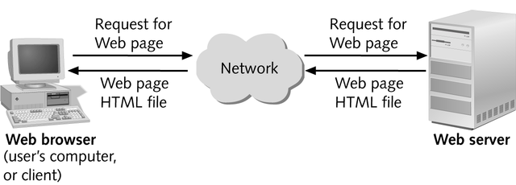
Web Basics
Web client/server architecture

Slide 6
Communication Protocols and Web Addresses
Communication protocols
  Agreements between sender and receiver regarding how data are sent and interpreted
  Internet is built on two network protocols:
    Transmission Control Protocol (TCP)
    Internet Protocol (IP)

Slide 7
Communication Protocols and Web Addresses
Packets
  Data that can be routed independently through Internet
Domain name
  Represents an IP address
A domain names server maintains tables with domain names matched to their IP addresses
Internet Service Providers (ISPs)
  Provide commercial Internet access

Slide 8
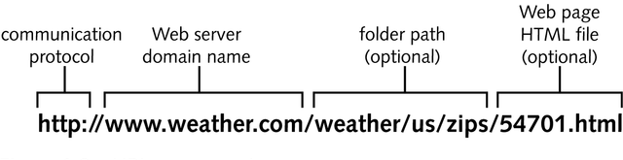
Communication Protocols and Web Addresses
Hypertext Transfer Protocol
  Communication protocol used on the Web
Web address
  Also called Uniform Resource Locator (URL)
URL Components

Slide 9
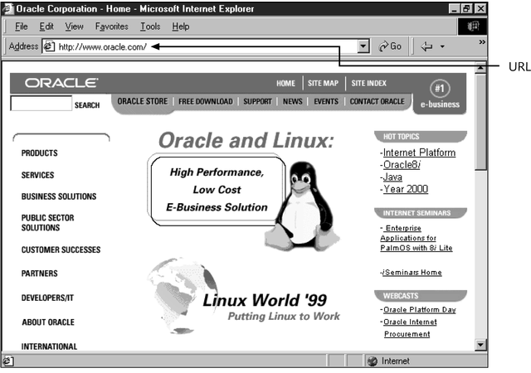
Communication Protocols and Web Addresses
If folder path is not specified, Web server assumes default starting point is Web server’s root document folder
URL that displays default home page

Slide 10
Communication Protocols and Web Addresses
Internet URLs
  Specify a Web server or domain name
  Specify communication protocol as first part of URL
File URL
  HTML file stored on user’s hard drive

Slide 11
Running Multiple Listener Processes on the Same Web Server
Running multiple listeners is managed through the concept of ports
Ports
  Identified by a number that specifies which TCP/IP-based listener or server running on a computer, at a given IP address, is going to receive a message coming in from the network

Slide 12
Database Basics
Databases store an organization’s data in a central location, using a standardized format
Database management system (DBMS)
  Program used to manage database data and user access

Slide 13
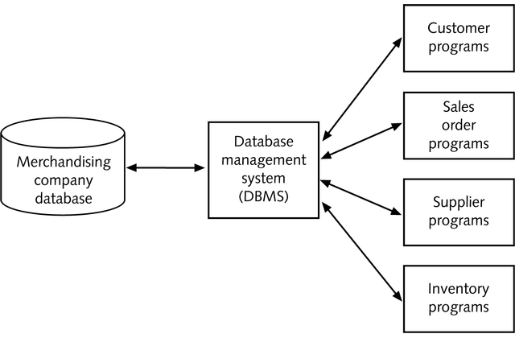
Database Basics
Relationships among database, DBMS, and programs

Slide 14
Personal and Client/Server Databases
As distributed computing and microcomputers became popular during the 1980s, two new kinds of databases emerged:
  Personal databases
  Client/server databases

Slide 15
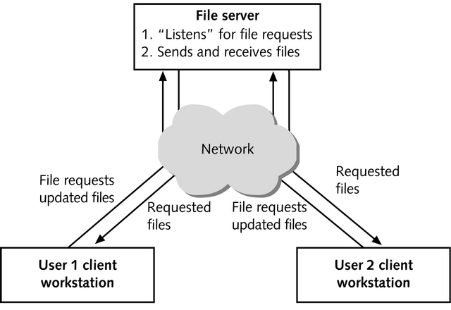
Personal and Client/Server Databases
Using a personal database for a multiuser application

Slide 16
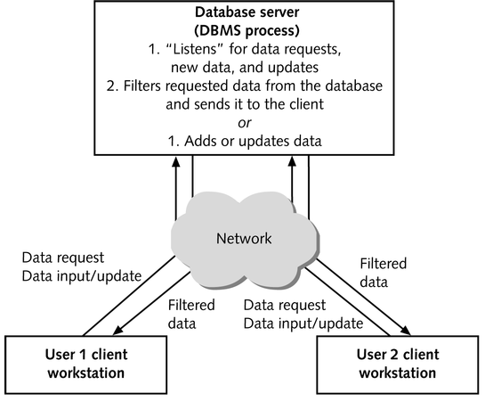
Personal and Client/Server Databases
Using a client/server database for a multiuser application

Slide 17
Personal and Client/Server Databases
In a personal database system used for a multiuser application, when a client workstation fails because of software malfunction or power failure, the database is likely to become damaged due to interrupted action queries that can negatively affect other users
  An action query can change the data in the database by updating, inserting, or deleting data

Slide 18
Personal and Client/Server Databases
A client/server database is less affected when a client workstation fails
  The failed client’s in-progress queries are lost, but the failure of a single client workstation does not affect other users
In case of server failure in a client/server database, a central synchronized transaction log contains a record of all current database changes

Slide 19
Personal and Client/Server Databases
Optimistic locking
  Hopes that two competing transactions will not take place at the same time
Transaction processing
  Refers to grouping related database changes into batches that must either all succeed or all fail

Slide 20
Personal and Client/Server Databases
Client/server database systems have a built-in security model that can be used to:
  Limit the operations that users can perform on the database
  Limit the data a user can access
Personal databases have fewer security options
  Not as flexible to use and maintain as those offered by client/server database systems

Slide 21
Personal and Client/Server Databases
Client/server databases are essential for:
  Database applications where many users might be inserting, updating, or deleting data at the same time
  Mission critical applications
  Systems requiring a robust security system to govern user data access

Slide 22
Personal and Client/Server Databases
Personal databases are useful:
  For Web installations where the only database operation is viewing data and no action queries are used
  Where less robust recovery and security systems can be tolerated

Slide 23
Personal and Client/Server Databases
Longstanding and useful guideline
  When a personal database is used for multiuser applications, usage should be limited to no more than 10 concurrent users if action queries are allowed
If security or the ability to recover from client or server failures is important, use a client/server DBMS regardless of the number of concurrent users

Slide 24
Dynamic Web Pages
Static Web page
  Page content established at the time page is created
  Useful for displaying data that doesn’t change often, and for navigating between HTML Web page files
Dynamic Web page
  Also called an interactive Web page
  Page content varies according to user requests or inputs

Slide 25
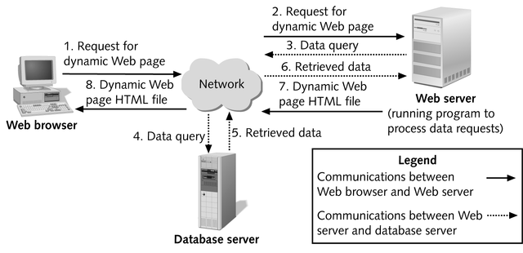
Dynamic Web Pages
Database-driven Web site Architecture

Slide 26
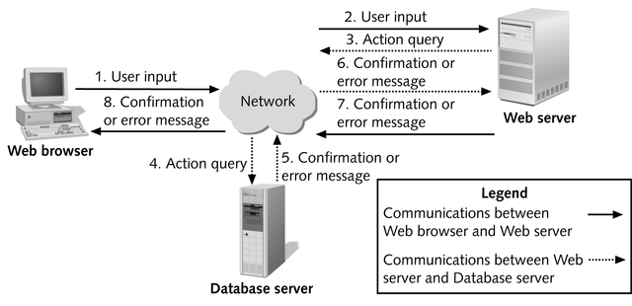
Dynamic Web Pages
Database-driven Web site architecture for action query

Slide 27
Approaches for Creating Dynamic Web Pages
In server-side processing, the Web server:
  Receives the dynamic Web page request
  Performs all of the processing necessary to create the dynamic Web page
  Sends the finished Web page to the client for display in the client’s browser

Slide 28
Approaches for Creating Dynamic Web Pages
Client-side processing
  Some processing is done on the client workstation, either to form the request for the dynamic Web page or to create or display the dynamic Web page

Slide 29
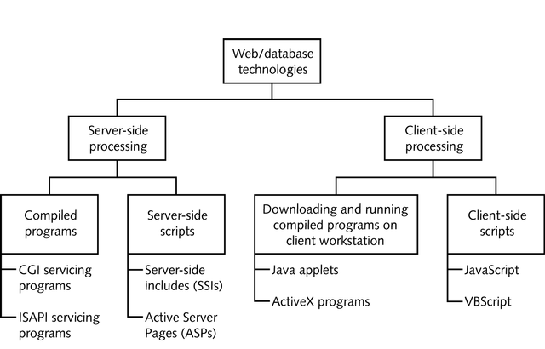
Approaches for Creating Dynamic Web Pages
Server-side and client-side Web database technologies

Slide 30
Client-side Processing
One approach to client-side processing involves downloading compiled executable programs stored on the Web server to the user’s Web browser and then running them on the user’s workstation
  This program interfaces with the user and, as needed, sends and retrieves data from a database server
  A Java applet uses this approach

Slide 31
Client-side Processing
Java
  Programming language that is a simplified subset of C++
  Commonly used to create Web applications, called Java applets, that can be downloaded from a Web server to a user’s browser and then run directly within the user’s browser
  Java applets run identically on any operating system and with any Web browser

Slide 32
Client-side Processing
Microsoft’s ActiveX also sends a compiled executable program to the user’s workstation
ActiveX program are generally used to create intranet applications
  An intranet is a self-contained internal corporate network based on Internet protocols but separate from the Internet

Slide 33
Client-side Processing
Another client-side processing approach involves client-side scripts
  Allows uncompiled code in languages such as JavaScript or VBScript to be typed into the HTML document along with the static HTML text
  More complex user interfaces are possible with this approach than with straight HTML
  Allows user inputs to be checked for correctness on user’s workstation rather than on Web server

Slide 34
Server-side Processing
The most common server-side dynamic Web page technology uses HTML forms
  Enhanced documents designed to collect user inputs and send them to the Web server
  HTML forms allow users to input data using text boxes, option buttons, and lists
  When the form is submitted, the servicing program on the Web server process the form inputs and dynamically composes a Web page reply

Slide 35
Server-side Processing
Common Gateway Interface (CGI) protocol
  Used as a method for communicating between the HTML form and the servicing program
  Disadvantage of using CGI-based servicing programs is that each form submitted to a Web server starts its own copy of the servicing program, potentially causing memory problems for the Web server

Slide 36
Server-side Processing
Web server vendors have developed proprietary technologies to process form inputs without starting a new copy of the servicing program for every form
  Netscape’s Netscape Service Application Programming Interface (NSAPI)
  Microsoft’s Internet Server Application Programming Interface (ISAPI)

Slide 37
Server-side Processing
Another approach for creating dynamic Web pages using server-side processing uses server-side scripts
  Server-side script is uncompiled code included within an HTML Web page file to extend its capabilities
  Examples of technologies using this approach include Server-side includes (SSIs) and Microsoft Active Server Pages (ASPs)

